Slide 1


Slide 2
CALS Event Planning with SmartSheet
How to save trees and keep organized!

Slide 3
Project Background
Request for IT Help
Event Planning Discovery
How can event planning process be improved?
SIPS Tool Demo
Test drive the software.
https://help.cals.cornell.edu
What tools are used on campus or available commercially?
Which tool best fits our need and is easy to use?
SIPS submits CALS OIT Software Solution Request
Notes:
Request:
IT software solution form
Discovery:
What are the requirements?
What tools can meet the needs? Project Management tools are the best fit.
Explored tools like Cvent and R25 that are already used on campus.

Slide 4
Why SmartSheet?
Easy to use online collaboration tool.
Similar to Excel yet as powerful as a database.
Collaboratively track event planning work in one place.
Very flexible- could be used for variety of work.
Cost is reasonable.
Used extensively, and enthusiastically, in AAD & Law.

Slide 5



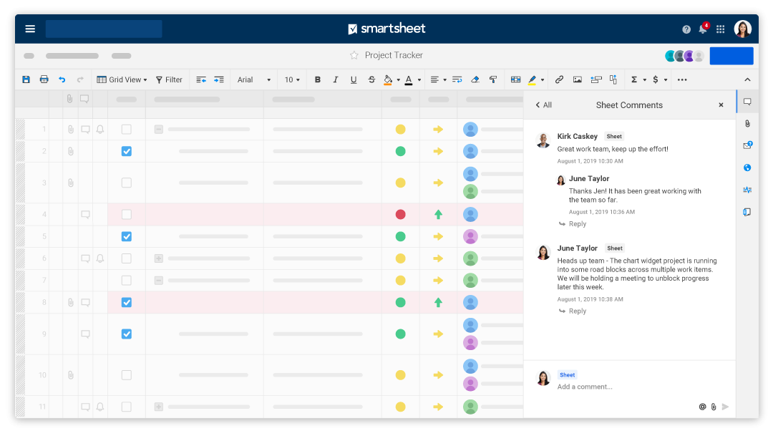






SmartSheet & Event Planning
Event Templates
Resource
Management
Dashboards
Forms
Notifications
Mobile App
Multiple Views
Automation
Content
Collaboration
Online Training
Notes:
EVENT TEMPLATES
Track event tasks & data online and in a single place.
Lots of templates to get you started OR create your own.
Share templates between departments.
Scales well so departments can work independently.
It's project management software - track anything you can think of.
FORMS
Use forms to create events in the system.
Collaborate with people involved or attending events.
Not everyone needs an account.
AUTOMATION
Building your timeline and task due dates automatically.
Use workflows to send email notifications and templates, such as seminar announcements.
RESOURCE MANAGEMENT
Assign tasks to people with due dates.
Improved coverage - What work needs to be accomplished if someone's out sick?
Track work that’s assigned to people who are not in SmartSheet.
REMINDERS AND NOTIFICATIONS
Keep track of all work for events.
CONTENT COLLABORATION
Visit schedules can be publicized to track and fill time slots.
Data is online and in a single place.
No longer in people’s individual email.
No more paper folders.
Upload attachments like contract copies.
DASHBOARDS
Reports of events, tasks, budgets, status
MOBILE APP
Take event management on the go.
Track tasks remotely as you head from event to event or are trying to track things out on the AG Quad.
Works well with other tools like google docs.
ONLINE TRAINING
10 Personal 30 minute training sessions are included annually.
Lots of short videos with tips and tricks.
MULTIPLE VIEWS
Spreadsheet, Gantt charts, Calendar

Slide 6
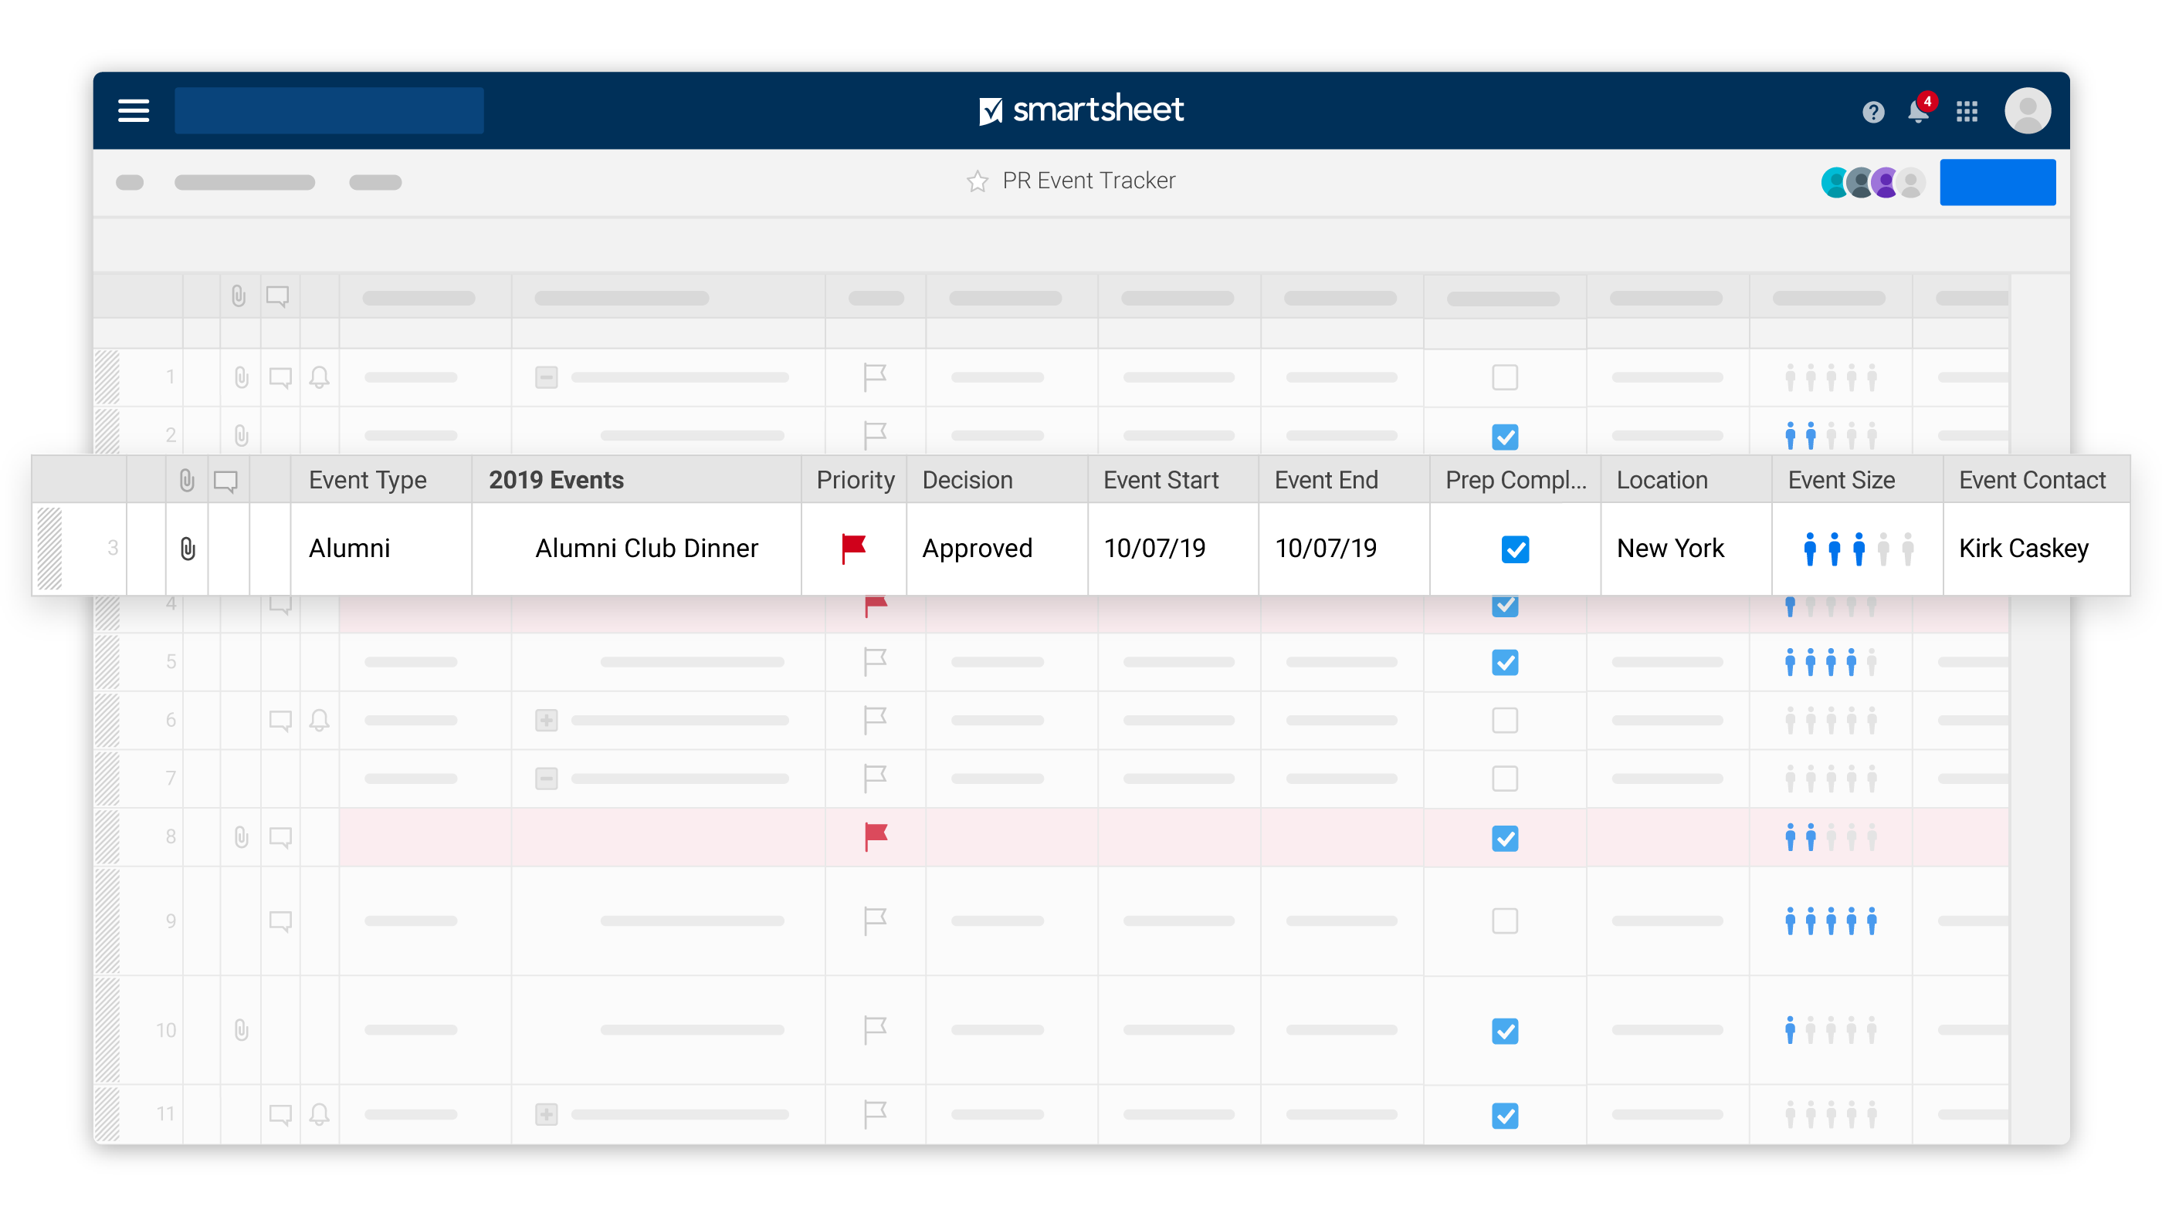
Demo Time!

Slide 7
The Cost
$325 per license per year
Licenses are only required for people creating and managing work in SmartSheet. (1 license per email address)
Event contributors do not need licenses.
Free use of templates and online training.
Includes ten 30 minute personal help/training sessions.
(10x/license/year)
Notes:
What can unlicensed users do?
https://help.smartsheet.com/articles/1155182-sharing-permission-levels?_ga=2.238486851.2140156758.1580942507-475554561.1580942507

Slide 8
Event Planning Pilot
Create small working group
Define functionality needed to help event planning.
Work with SmartSheet to create templates and dashboards.
We’ll need volunteers!

Slide 9
CALS Roll-out
Purchase licenses for interested departments.
Share event management templates and setup to departments.
On-boarding training.
Learn how to customize the templates for your event planning process.
SmartSheets Event Planning community to share tips and best practices

Slide 10
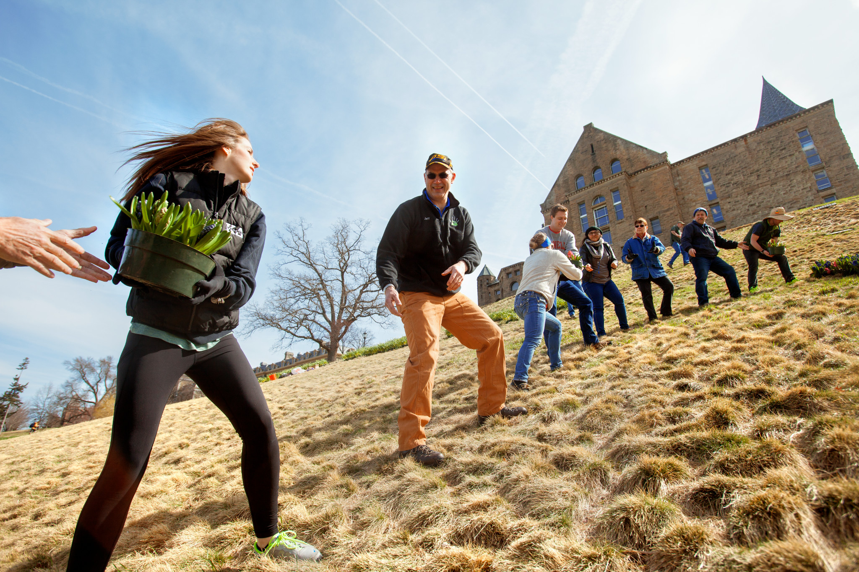
Pilot Volunteers & Licenses
Fill out the survey if you’re interested.
Reach out to Kelley with any questions
Notes:
https://cornell.qualtrics.com/jfe/form/SV_aWz2XF5HyRHgFb7

Slide 11

Questions
CALS Event Planning Pilot Site
https://cals.cornell.edu/faculty-staff/information-technology/cals-it-services/application-portfolio/smartsheet
Event Planning in SmartSheet…
https://www.smartsheet.com/s/event-planning

Slide 12


Slide 13
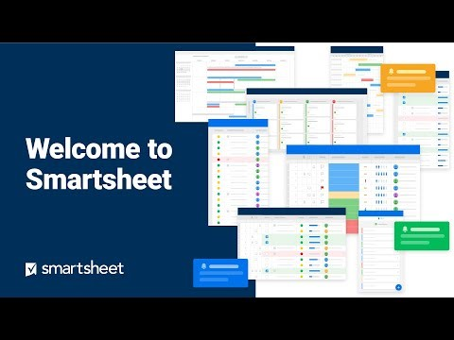
What is SmartSheet?
Event Planning with SmartSheet: https://www.smartsheet.com/s/event-planning
Notes:
Welcome to SmartSheet: https://youtu.be/VW24QqLxk4Y
Event Planning details: https://www.smartsheet.com/s/event-planning

Slide 14
History
SIPS Software Solution Request – How to efficiently manage events?
25Live space reservations - just a piece of the puzzle.
Discovery to investigate Event Planning software.
SIPS demos “project management software” tools.
Selection of SmartSheet.

